Slide 1
INFORMATION SECURITY
OVERVIEW

Slide 2
Introduction
Information technology is the vehicle that stores and transports information—a company’s most valuable resource—from one business unit to another.
But what happens if the vehicle breaks down, even for a little while?
As businesses have become more fluid, the concept of computer security has been replaced by the concept of information security.
Because this new concept covers a broader range of issues, from the protection of data to the protection of human resources, information security is no longer the sole responsibility of a discrete group of people in the company; rather, it is the responsibility of every employee, and especially managers.

Slide 3
Information Security is the process of protecting information availability, data integrity, and privacy.
No collection of products or technologies alone can solve every information security problem faced by an organization.
Effective information security requires the successful integration of:
security products such as firewalls, intrusion detection systems, and vulnerability scanners
technologies such as authentication and encryption
security policies and procedures

Slide 4
Primary Goals
CIA triangle known as security triad tells the primary goals of Information Security.
Confidentiality
Integrity
Availability(CIA)

Slide 5
Confidentiality
Confidentiality of information ensures that only those with sufficient privileges may access certain information.
When unauthorized individuals or systems can access information, confidentiality is breached.
To protect the confidentiality of information, a number of measures are used:
Information classification
Secure document storage
Application of general security policies
Education of information custodians and end users

Slide 6
Integrity
Integrity is the quality or state of being whole, complete, and uncorrupted. The integrity of information is threatened when it is exposed to corruption, damage, destruction, or other disruption of its authentic state.
Corruption can occur while information is being compiled, stored, or transmitted.
Integrity means that data cannot be modified without authorization.
Eg: Integrity is violated when an employee deletes important data files, when a computer virus infects a computer, when an employee is able to modify his own salary in a payroll database, when an unauthorized user vandalizes a website, when someone is able to cast a very large number of votes in an online poll, and so on.

Slide 7
Availability
Availability is the characteristic of information that enables user access to information without interference or obstruction and in a required format. A user in this definition may be either a person or another computer system.
Availability does not imply that the information is accessible to any user; rather, it means availability to authorized users.
For any information system to serve its purpose, the information must be available when it is needed.
Eg: High availability systems aim to remain available at all times, preventing service disruptions due to power outages, hardware failures, and system upgrades.

Slide 8
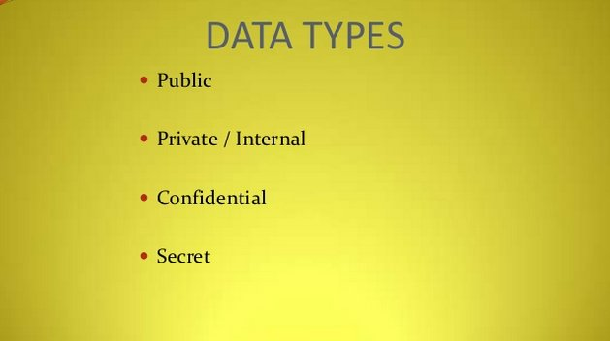

Slide 9
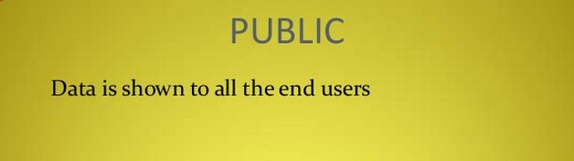

Slide 10
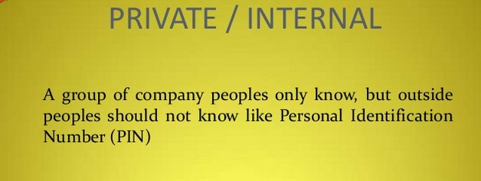

Slide 11
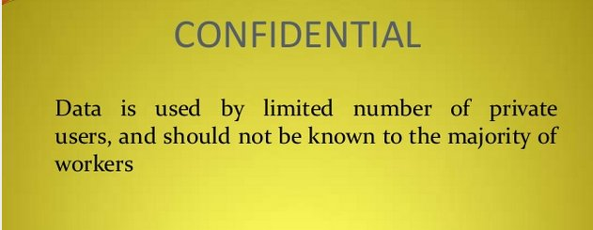

Slide 12
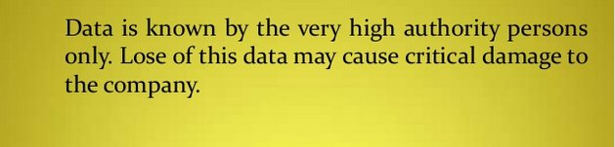
SECRET

Slide 13
ELEMENTS OF IS
Physical Elements
Guard , Camera, R-zone, Access rights
System Elements
Antivirus, Malicious S/W Detection Solution, disable USB ports
Process Elements
Authorized user/access control, S/W details ,log entry

Slide 14
Security Types
Physical security
Personal security
Operations security
Communications security
Network security
Information security

Slide 15
PHYSICAL SECURITY
Physical security, which encompasses strategies to protect people, physical assets, and the workplace from various threats including fire, unauthorized access, or natural disasters

Slide 16
PERSONAL SECURITY
Personal security, which overlaps with physical security in the protection of the people within the organization

Slide 17
Operations security
Operations security, which focuses on securing the organization’s ability to carry out its operational activities without interruption or compromise

Slide 18
COMMUNICATION SECURITY
Which encompasses the protection of an organization’s communications media, technology, and content, and its ability to use these tools to achieve the organization’s objectives

Slide 19
Network security
Which addresses the protection of an organization’s data networking devices, connections, and contents, and the ability to use that network to accomplish the organization’s data communication functions

Slide 20
Information security
Includes the broad areas of information security management, computer and data security, and network security.

